Slide 1

Robot DESIGN Lesson
Pneumatics

Slide 2
PNEUMATICS
Pneumatics use air to power the attachment
To pump up the air and store it (in a tank), you can use your hand or a motor
To release the air, you must trigger the switch
Set #9641: Pneumatics Add on Set

Slide 3
PNEUMATICS PARTS
Switch: Directs air to one of two outputs
T-piece: Connects hoses and directs air to both outputs
Cylinder – Piston that converts air pressure to movement
Pump: Pumps air for storage in tank
Air Tank: Holds air
Pressure Gauge: Measures the amount of air stored in the tank
Hose: Transfers air
Set #9641: Pneumatics Add on Set

Slide 4
Basic Pneumatic SET Up
Pump connects to an Air Tank using a Hose
The Air Tank connects to the middle air input on the Switch
Connect Hoses to the two air outputs on the Switch to whatever you want (e.g. Cylinder/Piston, second switch, connector, etc)
The Switch directs air to the two outputs based on its position.
Adding a Pressure Gauge lets you know how much air you have in your tank.
You can use a T-piece to direct the air from the Air Tank to both the Pressure Gauge and the Switch
Switch
Outputs:
Goes to piston or other switch
Input: From tank
Pump
To Gauge
To Tank
To Switch
To Cylinder/ Piston

Slide 5
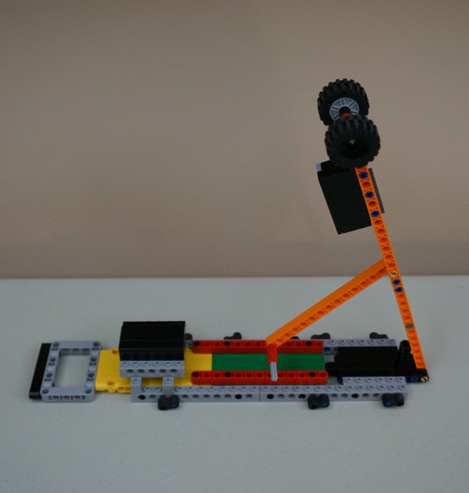
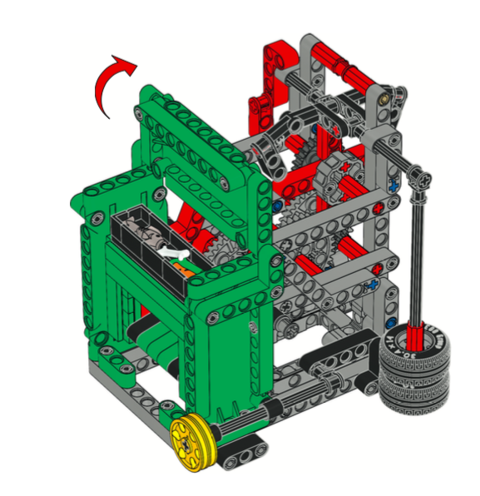
Gravity IS FREE
Examples:
Simple: Having something drop can create an easy way to trigger an action.
In the image on the right, the arm drops when set up correctly on the robot
Complex: The Composter from FIRST LEGO League Trash Trek used gravity to operate a clock mechanism
What can you create from LEGO that uses gravity?

Slide 6
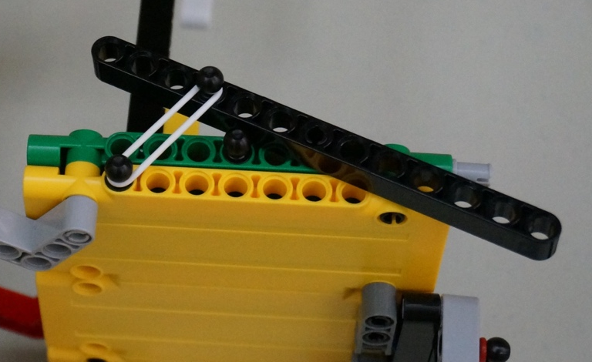
RUBBER BAND POWER
Rubber bands can be used to store energy and create pressure
When you release the pressure on the rubber band, you can lift, hit, push or pull
Pressure Tester model from FIRST LEGO League Body Forward

Slide 7

Credits
This tutorial was created by Sanjay Seshan and Arvind Seshan
More lessons at www.ev3lessons.com
This work is licensed under a Creative Commons Attribution-NonCommercial-ShareAlike 4.0 International License.

